Slide 1
Fuel Efficiency Prediction of a Car
By Shwetabh Kumar Gupta, Shaz Syyed

Slide 2
Contents
Introduction
Overview of the Dataset
Data Cleaning
Exploratory Data Analysis
Feature Engineering and Selection
Modelling
Conclusion

Slide 3
Introduction
The automotive industry is extremely competitive. With increasing fuel prices and picky consumers, automobile makers are constantly optimizing their processes to increase fuel efficiency.
The objective of this project is to study the relationship between Displacement, Horsepower, Cylinders, Acceleration, Weight and Miles Per Gallon(Mpg) and establish a model which would successfully predict fuel efficiency i.e Mpg of a car with a good accuracy.

Slide 4
Data Source
We have a dataset taken from the StatLib library which is maintained at Carnegie Mellon University. The dataset was used in the 1983 American Statistical Association Exposition. The data concerns city-cycle fuel consumption in miles per gallon.
Link- http://lib.stat.cmu.edu/datasets/ auto+mpg
This dataset contains 398 observations of 9 variables which includes continuous and categorical Features where each row corresponds to particular car features.

Slide 5
Understanding the Variables
The dataset contains mpg, cylinders, horsepower, weight, acceleration, etc., which should all be self-explanatory.
Displacement is the volume of the car’s engine, usually expressed in litters or cubic centimetres.
Origin is a discrete value from 1 to 3. This dataset does not describe it beyond that, but for this notebook we assumed 1 to be American-origin vehicle, 2 is European-origin, 3 is Asia/elsewhere.
Model year is given as a decimal number representing the last two digits of the 4-digit year (eg.-1970 is model year = 70).
Our model has a dimension of (398,9) which includes continuous and categorical Features

Slide 6
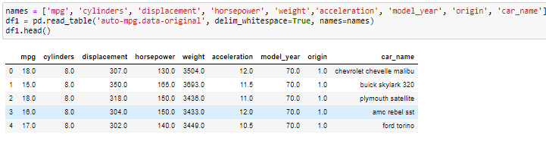
Overview of the dataset

Slide 7
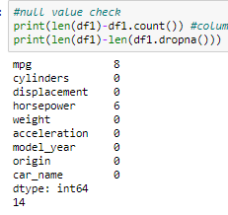

Data Cleaning
We first checked for Null Value in the Auto Mpg Dataset and found a total of 14 NAN values in Mpg and Horsepower. We removed them with dropna() function.

Slide 8
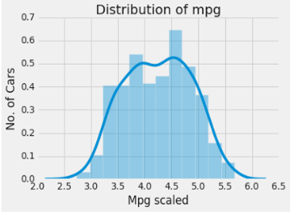
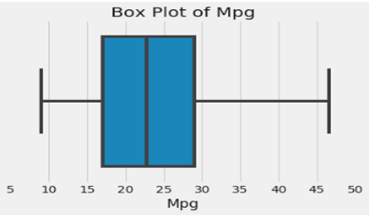
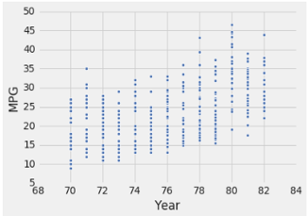
Exploratory Data Analysis
The Target Variable Mpg was right skewed so we applied Box Cox Transformation to remove skewness.
The Target variable seem to have no outliers when we inspect the box plot.
Scatterplot of year showed it to be linearly (increasing) with Mpg variable.

Slide 9
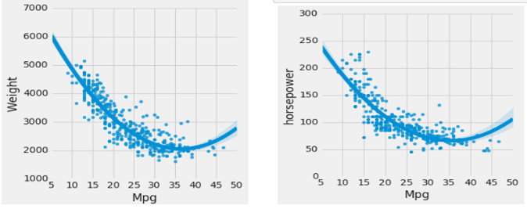
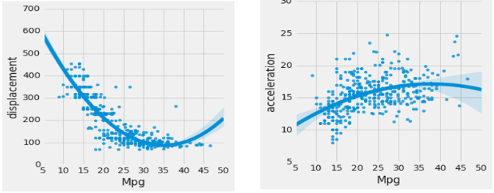
Exploratory Data Analysis
We see that displacement, weight and horsepower seem to be inversely related to the target variable mpg whereas acceleration seem to increasing with variable mpg.

Slide 10
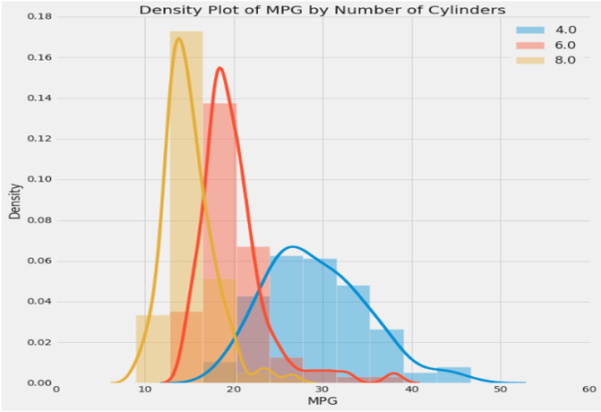
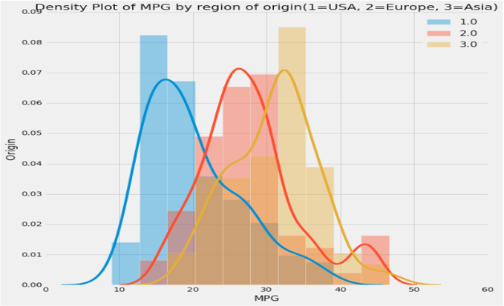
Exploratory Data Analysis
We try and plot the density plot of mpg by no. of cylinders and we see that a relationship exists between the input features acceleration and year and the target mpg. Mpg seems to increase linearly with these features.
Also we plot density plot of mpg by region of origin(1 for USA, 2 for Europe and 3 for Asia) and we conclude that a car made in Asia has a higher mgp then a car made in Europe on an average. A car made in Europe has a higher mpg that a car made in USA on average

Slide 11
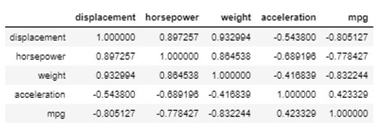
Exploratory Data Analysis
Now we calculate the Pearson’s correlation coefficient with and visualize it with the heat map. By this we get a confirmation that cylinder, displacement, weight are highly correlated to these features as well.

Slide 12

Feature Engineering and Selection
Previously we saw an inverse relation of mpg with displacement, weight, horsepower so here we take 3 new continuous variable named as inv_displacement, inv_weight, inv_horsepower( we have taken there inverse) and box coz mpg (normalized) data.

Slide 13
Modelling- Linear Regression
Here we split the data into train/test sets with a 70/30 ratio and find mean/variance of train set for scaling with the features- ['inv_displacement', 'inv_horsepower', 'inv_weight','acceleration’], then we applied the Linear Regression and we achieve these results:-
RMSE | 3.7170
R^2 | 0.7559

Slide 14
Modelling- Gradient Boosting
Here we fit the X_train and Y_train and get the parameters. And now we try to predict with X_test with gb.regresssor and here are the results we achieve:-
RMSE | 0.2672
R^2 | 0.8068

Slide 15
Modelling- Random Forest
We then fitted our training dataset we Random forest regressor. Here we get these results:-
RMSE | 4.658
R^2 | 0.6942

Slide 16
Modelling- RidgeCv with Polynomial Features
Here we scale the X_test, X_train, y_test and y_train and get X_test scaled, X_train scaled, y_test scaled and y_train scaled and then we use the Ridge CV with polynomial features with (0,2,10) as alphas and we make a pipeline and fit the model. With this we achieve these results.
RMSE | 0.8081
R^2 | 0.4362

Slide 17
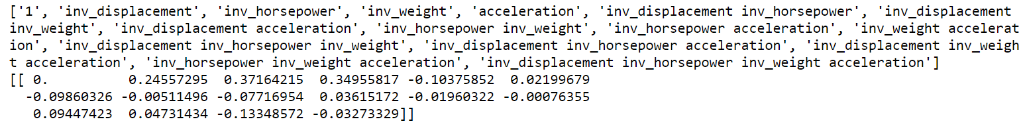
Important Features
Here we find the coefficients of the features so that we can get to know which features are important.

Slide 18
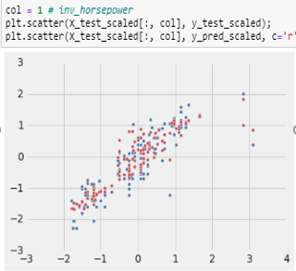
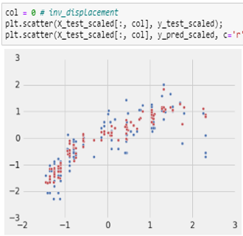
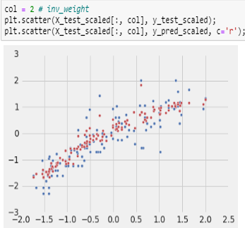
Important Features
-Now we make some plots to visualize accuracy of model predictions along with finding coefficient

Slide 19
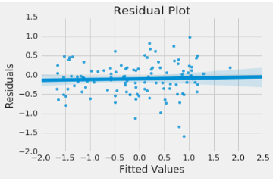
Residual Plot
And now we plot a residual Plot to see if our assumptions still hold true. And we don’t seem to have a pattern in the residual error which seems to be a good sign that there is no heteroscedasticity.

Slide 20
Conclusion
We see that R^2 value seems to be almost similar for RidgeCv with polynomial features and Gradient Boosting we choose to select the Gradient Boosting method due to relatively low RMSE value compared to other models here in and thereby would help us predict the fuel efficiency of the car with high accuracy.
Algorithms/Results | R^2 | RMSE
Multiple Linear Regression | 0.759 | 3.170
RidgeCv with Polynomial Features | 0.808 | 0.4326
Gradient Boosting | 0.8068 | 0.2672
Random Forest | 0.649 | 4.6589

Slide 21
Thank You

